Slide 1
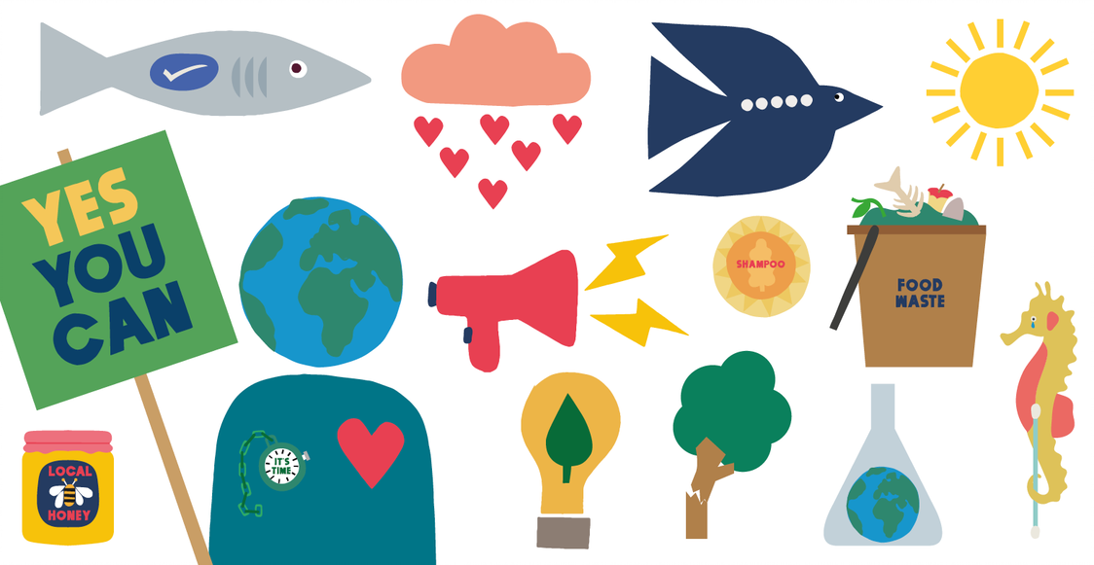
What you can do to help the planet: an illustrated guide

Slide 2
The future of humanity depends on the natural world. But we are facing a planetary emergency.
We're losing green spaces, animals and plants to deforestation, exploitation, urbanisation and global warming.
But hope isn't lost. If we act together, we can make a positive difference. Here's how to do your bit to protect nature.

Slide 3
Eat sustainably
Eat fruit and vegetables in season and grown locally - it helps to reduce carbon emissions.
Reduce the amount of meat and dairy you eat.
Buy food that is produced more sustainably, such as MSC (Marine Stewardship Council) fish
and UK Red Tractor assured items.

Slide 4
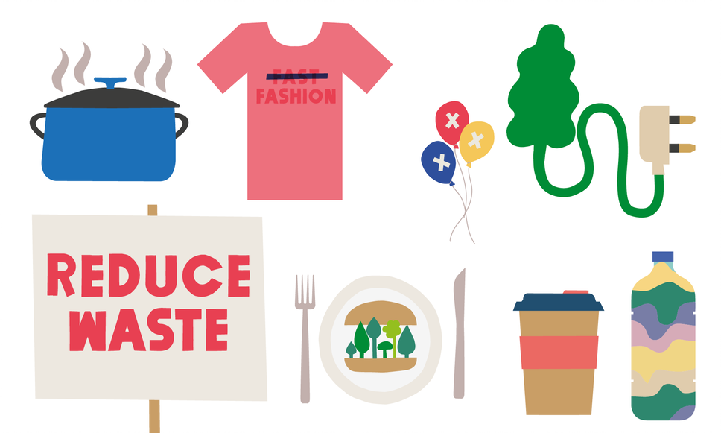
Reduce waste
Repair, reuse, donate or sell items rather than throwing them away.
Reduce the number of single-use items you're buying and swap them for reusable alternatives.
Good items to start with include coffee cups, water bottles and bags.
Make sure you recycle according to your local authority's guidelines.
Batch cook and freeze food or get inventive with leftovers to use up fresh fruit and vegetables.

Slide 5
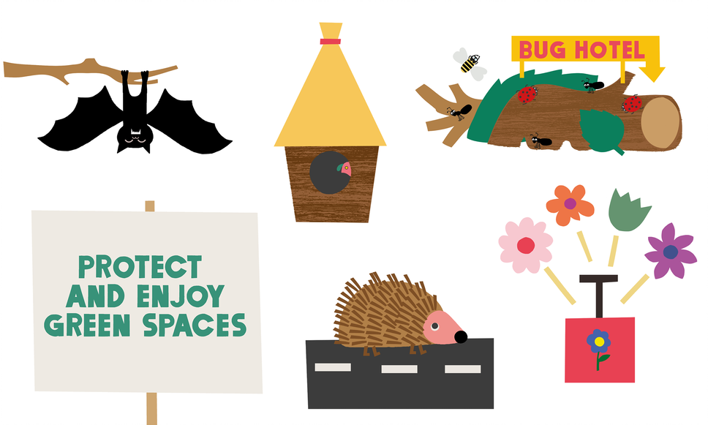
Protect and enjoy green spaces
Plant a window box with nectar-rich flowers - even a small space can make a change.
If you have a garden or green space, try to include a wide variety of plants to lengthen the flowering
season and support different kinds of wildlife. If not, help nurture a park or community garden near you.
Let your garden grow wild. Reduce the number of times you mow your lawn to encourage
plants to grow - they are a good source of food for birds.
Care for the wildlife that visits your space. Build a pond or hedgehog home, put up a bird box or a bee
hotel and avoid using harsh chemicals.

Slide 6
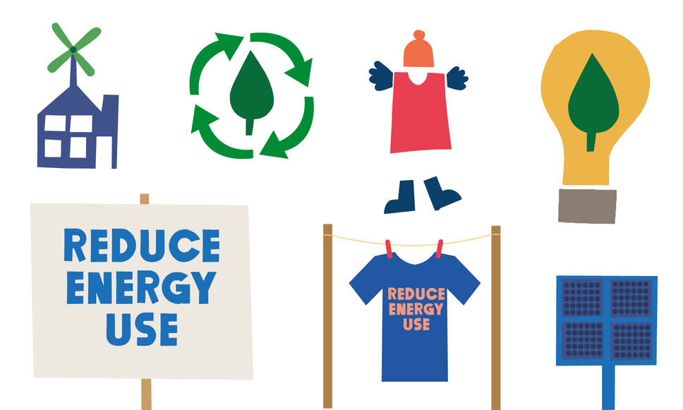
Reduce energy use
Turn off lights and electrical appliances when you're not using them.
Put on an extra layer before you turn up the heating.
Ensure your home is energy efficient.

Slide 7
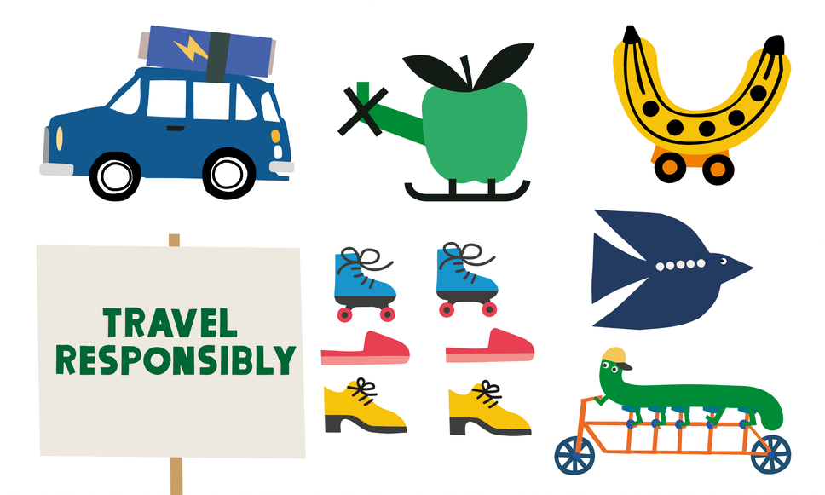
Travel responsibly
Leave the car at home and walk, cycle or use public transport wherever you can.
Cut back on flying and try to take the train if travelling around the UK or to
Europe.

Slide 8
Make your voice heard
Talk to friends and family about the changes you make.
Talk to those with the power to make change. That includes businesses, your local council, MP or school.
If you stop buying something because you have found a more sustainable alternative, let the shop know
why they’re losing your custom. It might nudge them to clean up their act.

Slide 9
Use and support science
Understanding changes to the environment can be confusing. If you want to find out more about what the science says, make sure you go to a trusted source like the Museum website or universities.
Share your interests by joining with other people and organisations. You can achieve much more together.
Museum scientists are working alongside colleagues all over the world to understand and reduce the impacts of climate change. Your support, however small, can help us continue the work.

Slide 10
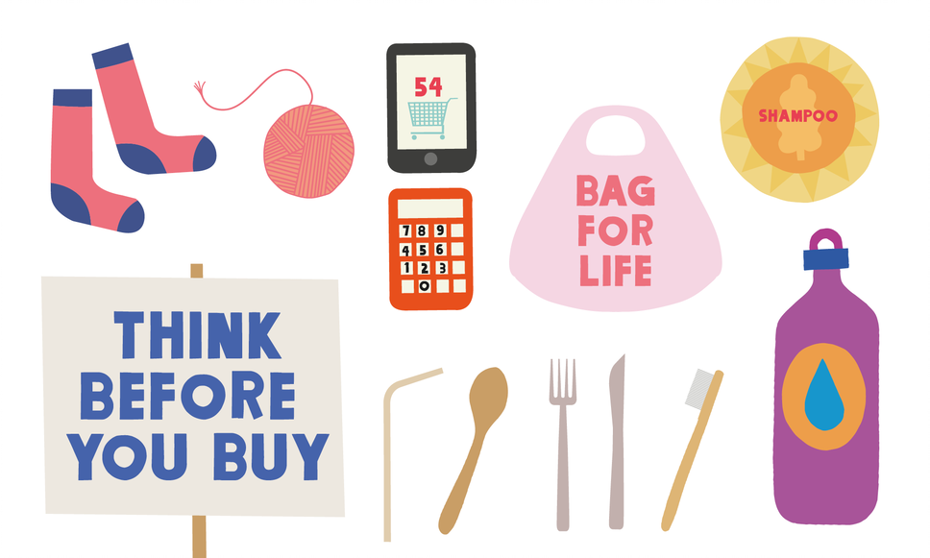
Watch what you buy
Plan your meals. Make a list and stick to it when you shop so that you don’t over buy.
Choose products with less packaging.
Ask yourself whether you need to buy something. The most sustainable option is using what you already own.
Buy sustainably sourced goods whenever possible. By doing so, you not only reduce your own environmental footprint, you also make a big difference to businesses that are trying to do the right thing.

Slide 11
Useful links
Eat sustainably
https://www.msc.org/uk
https://redtractor.org.uk/
Reduce waste
https://www.gov.uk/recycling-collections
Protect and enjoy green spaces
https://www.nhm.ac.uk/discover/how-to-attract-butterflies.html
https://www.nhm.ac.uk/discover/how-to-grow-a-wildflower-pot-for-pollinators.html
https://www.nhm.ac.uk/discover/how-to-grow-a-better-lawn-for-wildlife.html
https://www.nhm.ac.uk/discover/how-to-make-a-hedgehog-house.html
Reduce energy use
https://energysavingtrust.org.uk/hub/inspiration-home-improvement-project/
Make your voice heard
https://www.parliament.uk/get-involved/contact-an-mp-or-lord/contact-your-mp/
https://www.gov.uk/find-local-council
Use and support science
https://www.nhm.ac.uk/discover/news/2020/january/we-are-declaring-a-planetary-emergency.html
https://www.nhm.ac.uk/discover/anthropocene.html
https://www.nhm.ac.uk/discover/nine-ways-museum-scientists-are-protecting-our-planet.html

